Slide 1
Business Process Improvement Project
Project Selection Criteria:
Select an issue or opportunity that can be written as a problem statement.
Must be within your sphere of influence.
Is not an attempt to solve world hunger.
Uses data that is accessible to you or can be collected in a reasonable amount of effort/time.
You have the ability to measure the current and future state. You have access to baseline data or can collect it.
Preferably uses more continuous data (rather than all discrete data).
Fixing this problem will provide value. You should develop a business case to support working this issue (consider your time and others when calculating ROI.)
Examples:
Improve product quality
Reduce expenses
Improve the output of your organization
Decrease wait time

Slide 2
Problem Definition Worksheet - Complete each section below:
A) Problem Statement: Define your problem. What pains are you (or your customers, family, clients, etc.) experiencing? What is broken, wrong or not working? How do you know that you have a problem? What is telling you this? What is your evidence?
B) Business Impact: Why should you fix this problem? What is the estimated benefit for solving this problem? What is this problem worth in dollars? How will you measure success? What is your key output (y)?
C) Goals: What are your improvement objectives, goals or targets? How much “better” do you want to be? Quantify this goal.
D) Project Scope: What are your boundaries? What is the first step and last step of the process you need to fix? What is not within your scope?
E) Team: Who is the process owner/champion? Who do you need to work with or involve to analyze and/or impact this process?
F) Project plan:(very high-level): Estimate time (or date) per DMAIC step. Develop a rough timeline.
G) Process Map: What are the steps in the process you are trying to fix? Document the flow of process steps (of the process you are working to improve). This should be a high-level flow chart.

Slide 3
Data Collection and Analysis Paper - Requirements
Prepare a 1,500-1,700 word paper describing your method of data collection, tools of analysis and conclusions. Start by restating your selected business process and problem statement identified on your problem definition worksheet.
**Include either a data measurement plan or a data stratification tree. Include charts and graphs - but not as a separate file.**

Slide 4
Data Stratification Tree
Questions About Process
Stratification factors
X Variables
Measurements
Are orders impacted by the sales rep skill-levels (systems, product, pricing, listening, ability to follow the process)?
Skill level
% of orders per Sales Rep by skill level type
average & range of Sales Rep skill levels
What % of the calls are order related?
Type of call
% type of call
Does the Sales Rep have the right skills to improve selling more orders?
Training
no. of hours of training per month
total orders placed by month
% new orders are of total orders
% new order revenue of total revenue by month
Do new orders vary by month ?
Time of year (mo.)
Do new orders change by the receptiveness of the customer?
New Orders
Customer attitude
Example
(Output Y)
customer attitude rating by order type
Are orders impacted by call duration?
Average call duration for xyz order vs. other orders
Call duration
Are orders impacted by call wait time?
Wait time
wait time for each call
Are orders impacted by pricing issues?
Pricing Issue
% of calls transferred to OB due to pricing issues
Are orders impacted by whether or not the Sales Rep follows the written process?
Written process
mystery call /silent monitoring results (points per call)
Do new orders vary by the availability of the product (not on backorder)?
No.of backorders
% of orders resulting in backorders
Do the current targets impact orders?
Target settings (calls, orders, revenue)
calls, orders, total rev, rev per mo. per Sales Rep

Slide 5
Data Measurement Plan
Data Source and Location
How Will Data Be Collected
Who Will Collect
Data
When Will Data Be Collected
Target
Sample
Size
Performance Measure
Develop rating scale & assess performance
5/12
% of orders per Sales Rep by skill level type
average & range of Sales Rep skill levels
Susie
Susie
N/A
% type of call
Manual data collection
Use data collection form
All
5/11-6/2
1000 calls
no. of hours of training per month
John’s training spreadsheet
Manual data collection
John
5/20
12 mo
Example
total orders placed by month
% new orders are of total orders
% order revenue of total revenue by month
IB performance reports
Pull from report
Leanne
By 6/3
28 mo
customer attitude rating by order type
Manual data collection
Use data collection form
All
5/11 - 6/2
500 orders
Average call duration for new order vs. other
Manual data collection
Use data collection form
All
5/11 - 6/2
500 orders
wait time for each call
Obtain from other team
Aspect reports
Leanne
tbd
tbd
% of calls transferred to OB due to pricing issues
Manual data collection
Use data collection form
All
5/11 - 6/2
1000 calls
mystery call /silent monitoring results (points per call)
Monthly mystery call results
Compile Pamela’s data
Leanne
By 6/3
30
% of orders resulting in backorders
Manual data collection
Use data collection form
All
5/11 - 6/2
500 orders
calls, orders, total rev, per Sales Rep per month
IB performance reports
Pull from report
Susie
By 6/3
28 mo
No. of inbound calls per day
IB performance reports
Pull from report
Susie
By 6/3
28 mo
order revenue per Sales Rep per month
IB performance reports
Pull from report
Susie
By 6/3
28mo
Total revenue per month
IB performance reports
Pull from report
Susie
By 6/3
28 mo
Revenue per month by product type
SN report
Pull from report
Leanne
By 6/3
ytd

Slide 6
Data Collection and Analysis Paper - Requirements
Incorporate answers to the following questions within your paper:
What types of information did you measure (eg. cost, cycle time, WIP, changeover time, yield, machine utilization, scrap, rework, inventory)?
Have clear operational definitions been established for your inputs and outputs?
What kind of data did you collect (continuous or discrete data)?
What is your baseline measurement?
Did you collect your own data or did you use existing data?
How much data did you collect and why? What is your ideal sample size using the sample size formula? What is the risk given the chosen sample size?
How was your data collected? Describe the methods you used to collect it.
Where could you have measurement error? How much measurement error do you have? What could you do to minimize your measurement error?
What is the SQL for your old and new process?
What 4 -5 different tools and techniques did you use to analyze your data and why?
What is the data telling you? What did you discover?
What solutions did you propose and/or implement? Did you successfully improve your process? What did you learn about your process?
Depending on your problem-type incorporate the following if appropriate:
What is your measure of central tendency (measure of location)? Calculate it.
What is your data’s measure of dispersion? Calculate it.
Is your process (old and new) in control?

Slide 7
Storyboard Objective
Each Storyboard should:
  Be presented in 1 – 2 powerpoint slides
  Include the problem statement
  Tell a story
  Follow the DMAIC process
  Organize the tools used
  Be readable; summarize and condense exhibits where necessary
  Use arrows, call out boxes, and balloons to highlight questions and key learnings
  Display data supporting findings and conclusions
  Show expected results

Slide 8
EXAMPLE
Name of your project
Process owner: or your Name
Key Dates --->
Team
Launch
Define
Measure
Analyze
Improve
Control
DEFINE
MEASURE
ANALYZE
IMPROVE
CONTROL
TEAM MEMBERS

Slide 9
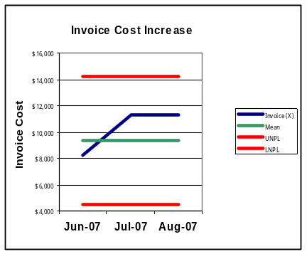
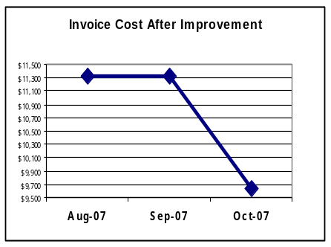
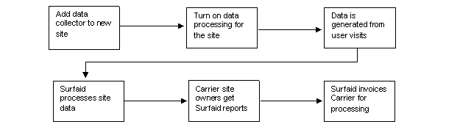
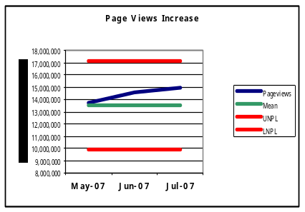
MBC638
Data Analysis
Web Metrics Cost Reduction
Process owner: John
Key Dates --->
Team
Launch
8/28
Define
9/3
Measure
9/5
Analyze
9/7
Improve
9/7
Control
10/15
One data
collector
per page
DEFINE
MEASURE
ANALYZE
IMPROVE
Problem
Invoice cost increasing
Page view volume increase
starts with data collector changes
Fee for web
Analytics Service up over 20%
$
More than one data collector found on some pages
Invoice cost lowered 15%
CONTROL
Annual Budget
is at risk of overrun
Data collector tag instructions
added to operational definitions
Page view volumes are reviewed
Monthly
- Invoices are reviewed monthly
- Control charts are maintained
C_{pk} = 0.382
Page view volume increasing
TEAM MEMBERS
Joe, Pat and Dave

Slide 10
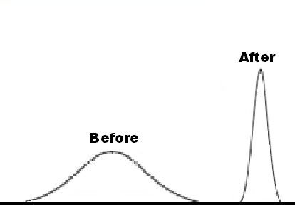
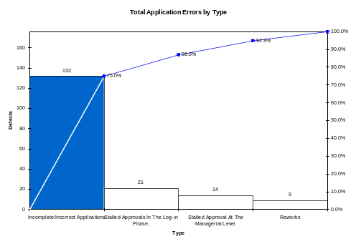
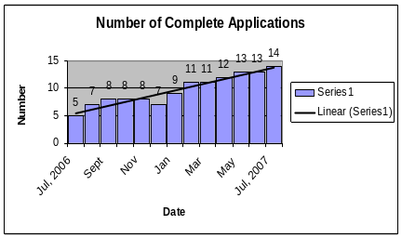
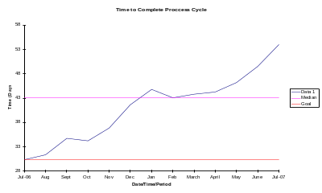
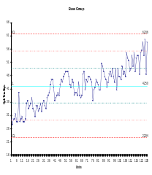
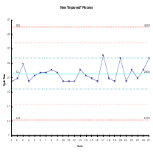



Process Improvement Project – Cycle Time Reduction
Process owner: Dan
Key Dates --->
Team Launch
8/23
Define
9/08
Measure
10/16
Analyze
10/24
Improve
10/31
Control
On-Going
DEFINE
MEASURE
ANALYZE
IMPROVE
It takes 43 days to process a grant application. Only 8% of applications are being processed within 30 days of receipt. The time to process the application has lead to unhappy applicants and staff who are finding more and more of their daily work time being devoted to “grant administration.” The funding levels available to applicants and the number of applications are expected to increase in the near future, which has the potential to compound the problem.
Defects/delays are inherent in the current process. Current SQL is 1.9
The Number of applications received is increasing.
New Application Procedure =
Less Mistakes & Quicker Cycle Time
The time to complete a process cycle is also increasing.
Problem: Incomplete and inaccurate applications were identified as the primary factor leading to defects in the process cycle.
Solution: New Application process incorporating drop down menus
CONTROL
The defect rate reduced from 93% to 32%
Before
After
↑ Number of Applications + ↑ Cycle Process Time __Tough Times Ahead
Monthly monitor and review procedure is in place. Out of control signal = action plan.
PROJECT TEAM: Dan • Mary • Karen • Linda • Peter
BUSINESS CASE: $54,000 in annual processing costs

Slide 11
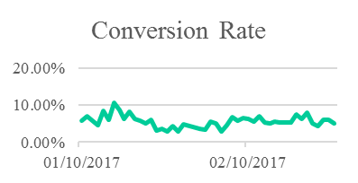
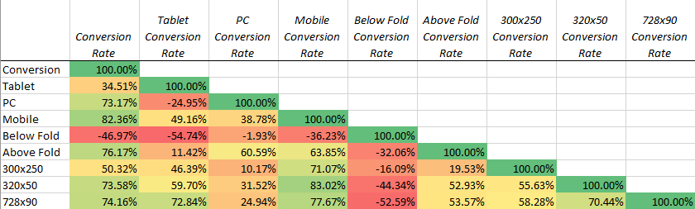
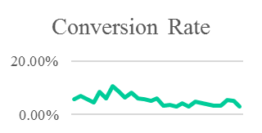
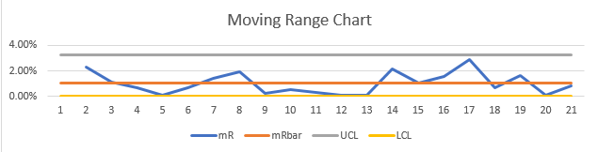
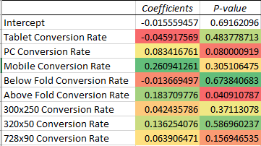
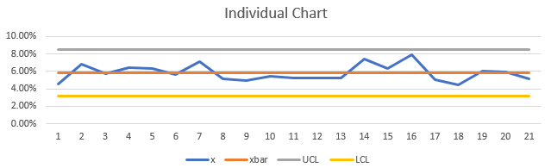
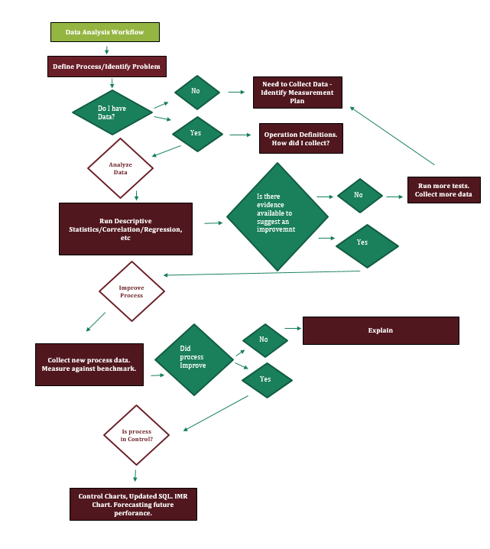

Increasing Conversion Rates amongst Programmatic Online Display Efforts
Process owner: Jacob Dineen
Key Dates --->
Team Launch
January 10th
Define
January 20th
Measure
Jan 10th-Feb 5th
Analyze
Feb 5th/6th
Improve
Feb 6th- Feb 26th
Control
Ongoing
Process improved.
+ $3600/Month.
6% Increase in Conversion Rate
DEFINE
MEASURE
ANALYZE
IMPROVE
Conversion Rate
Mean | 0.054695725
Standard Error | 0.004013695
Median | 0.055988315
Mode | #N/A
Standard Deviation | 0.020068477
Sample Variance | 0.000402744
Kurtosis | 0.427314139
Skewness | 0.781830668
Range | 0.077373131
Minimum | 0.029200574
Maximum | 0.106573705
Sum | 1.367393132
Count | 25
Problem/Definition
Low conversions rates on the identified platform. I would deem any positive direction a success, but because there is a standard deviation present in the daily data, I will shoot for somewhere between a 10-20% increase in mean conversion rate, using historical data from the previous month as a benchmark. For example, I am currently generating around a 5% conversion rate day over day, meaning that my ads are driving 5 out of 100 people to engage not only with the ad, but with the designated landing page they click through to. If I could influence that final conversion rate by 10%-20%, I would see an increase to 5.5% or 6%, overall.
Business Impact
If my conversion rate increases by 10%, there is a direct impact on the cost per individual conversion. The impending impact would result in 10% more dollars to spend during any given month to pursue further leads- This equates to roughly 6,000$ per month.
Problem and impact on business if process is improved. Measuring continuous data.
Average conversion rate, at a daily level, increased 6%. Perhaps more important than my average are the additional statistics noted above, such as min/max, range, and standard deviation. These metrics all moved in a more positive direction that indicates my process isn’t quite as wonky, and my output should be more predictable moving forward.
Eliminate bad predictor variables. Isolate key performance driving variables and shift weight towards them
Device Type: Shift a majority of spend into PC.
Ad Format/Size: Shift a majority of spend into 300x250 and 728x90 ad sizes.
Fold: Shift a majority of spend into ‘Above the Fold’
Defect = Conversion Rate < Average Conversion Rate of each process
Identified Critical Inputs and Outputs to Measure. Chi Squared test showed relationship prevalent between ad size/device type and performance
Process is in control/within limits.
Control
SQL: 2.7
Yield: 88.50%
Examined process and determined statistical relevance/sample
SQL: 2.8
Yield: 90.30%
Descriptive, Chi Square, Correlation, Regression, Time Series Used. Variable Relevance determined.
Process is within upper and lower control limits. 6% increase in conv. rate nets $3600 extra per month for media spending.
TEAM MEMBERS
Jacob Dineen

Slide 12
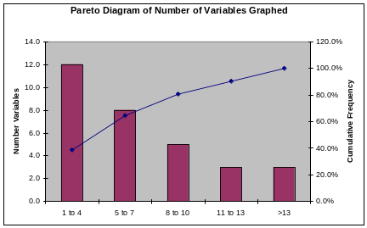
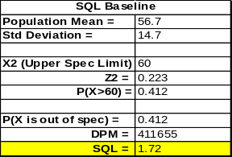
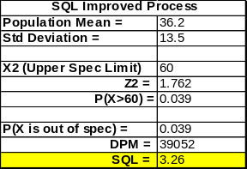
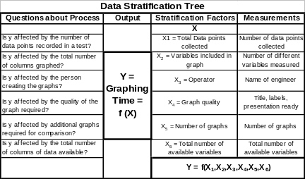
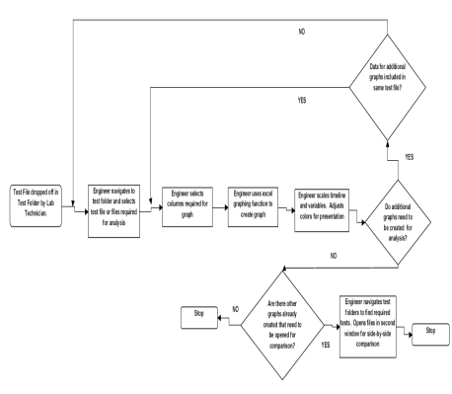
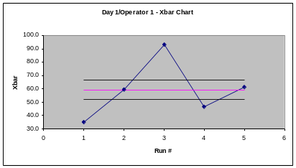
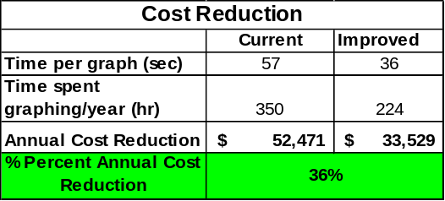
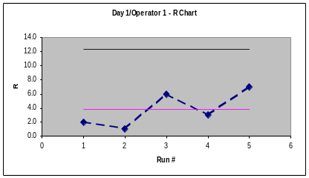
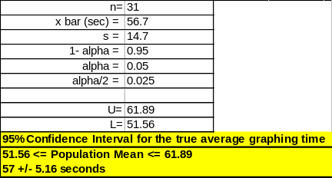
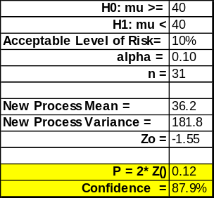
Process Improvement Project – Graphing Time Reduction
Mike – MBC 638
Key Dates --->
Team Launch
5/11/08
Define
5/19/08
Measure
5/26/08
Analyze
6/6/08
Improve
7/4/08
Control
On-Going
DEFINE
MEASURE
ANALYZE
IMPROVE
Before
After
Extensive graphing is required for good data analysis of lab qualification testing
350 Engineer hours in the department are spent on repetitive graphing procedures within Excel. This equates to $52,471/year
A 30% reduction in graphing time could result in a $15,741 annual savings.
Identified Critical Inputs and Outputs to Measure
Pareto showed that 80% of graphs consisted of 8 variables or less
Sigma Quality Level
Increased from 1.72
to 3.26
Eliminated wasteful, repetitive steps that can be automated with Excel Macros
R Charts in control.
Xbar Charts show ability to
measure differences
PTR = 0.22
$
=
$18,943 annual cost reduction!
$
Control
Hypothesis test indicates 88% confidence that new process meets the goal of at least a 30% improvement in graphing time
Maintain Revision Control on original spreadsheet macros
Provide to Engineering Department
Survey engineers for usage in 3 months
95% confidence interval that true graphing time is 57 +/- 5.16 seconds
Measurement Systems Analysis using X-bar, R Charts and Precision-To-Total Ratio
BUSINESS CASE: $18,943 Annual Cost Reduction if Implemented in Engineering Department

Slide 13

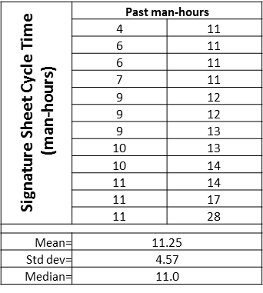
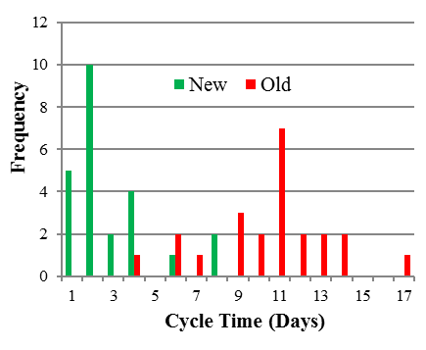
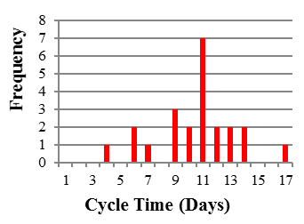


Process owner: Landon
Key Dates
Team Launch:
Define:
Measure:
Analyze:
Improve:
Control:
September 6
September 10
September 17
September 24
October 29
November 19
DEFINE
MEASURE
ANALYZE
IMPROVE
Problem Statement
Cycle time for a signature sheet averaged 11.25 days with each project manger spending about 11.25 hours for each purchase over $100,000.
SharePoint
Project manager signs form
Too many steps!
Electronic Signature Sheet
SLOW
Is project over $100,000?
No
Submit to Finance
Obtain engineering supervisor’s signature
Need to take PM out of all these steps
Business Impact
The average wage a project manager earns is $35/hr, therefore it costs $393.75 per project in just gathering signatures! At 144 projects a year this process costs $56,700 annually.
Obtain production supervisor’s signature
Cycle time reduced to 2.88 days!
Man-hours reduced to 0.20 hours!
Cost savings $55,692 annually!
SQL raised from 2.3 to 3.6 and rising!
High man-hours
High cycle time
Is it Thursday?
No
Wait for Thursday
Waste
SQL = 2.3
Obtain engineering director’s signature
P-value ≈ 0
Obtain finance supervisor’s signature
Success
CONTROL
Obtain group director’s signature
Finance Office will not accept old version of signature sheet.
Purchases tracked in SharePoint
Appraisal rated on compliance
Hypothesis Test
H_{o}: mu ≥ 11.25 hr H_{a}: mu < 11.25 hr
Submit form to Finance Department
TEAM MEMBERS
Landon, Engineering Project Managers, Finance Office, Stakeholders

